Slide 1

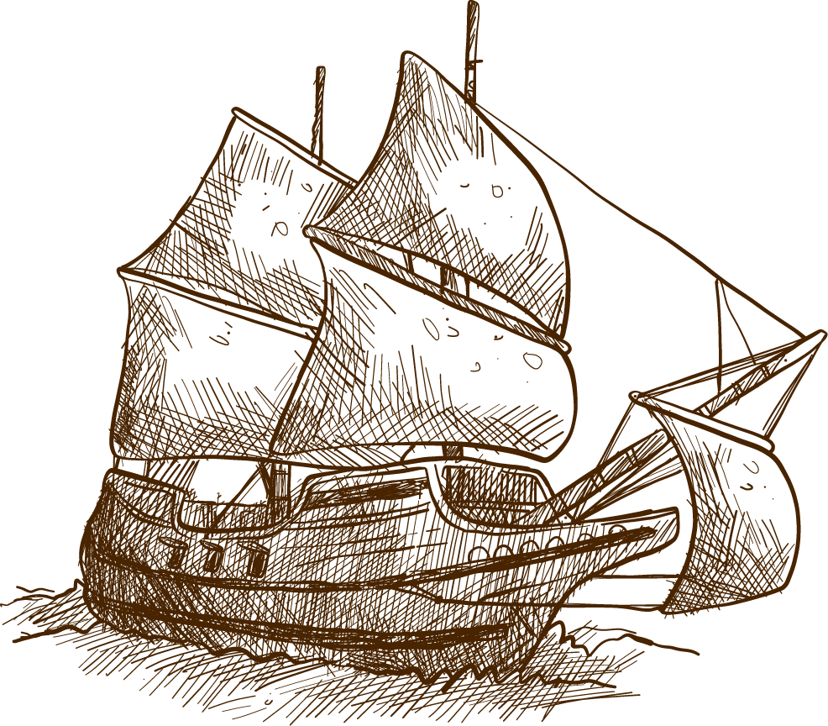


Leadership Theory Presentation
Rori Biszantz

Slide 2
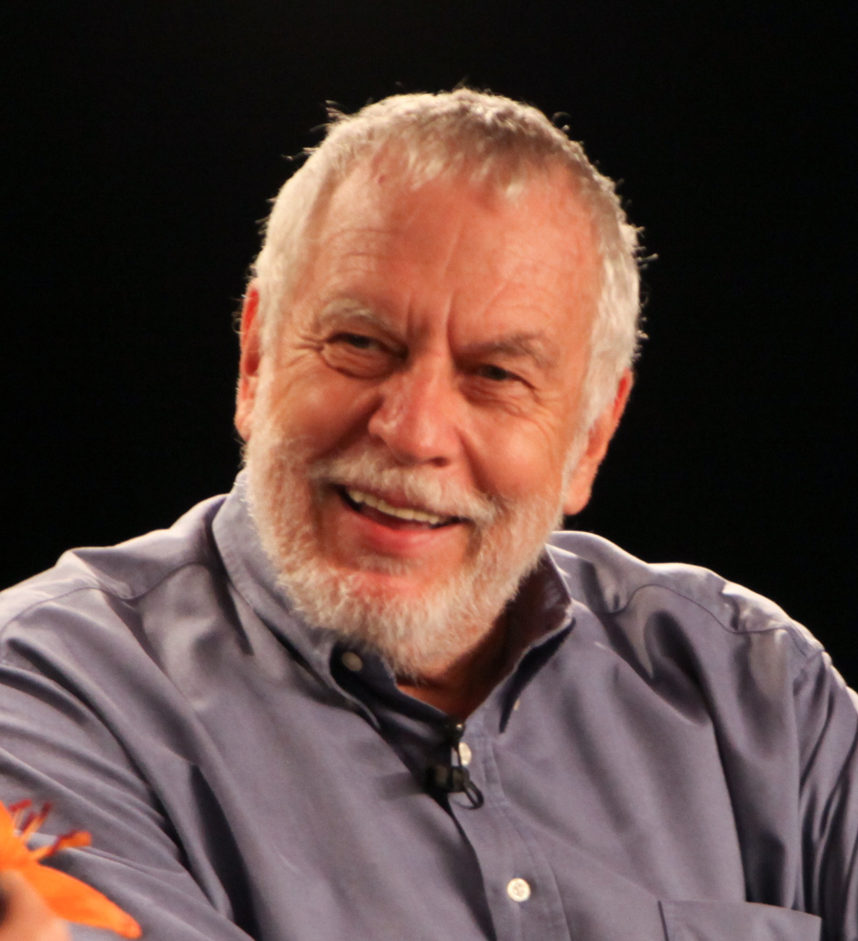

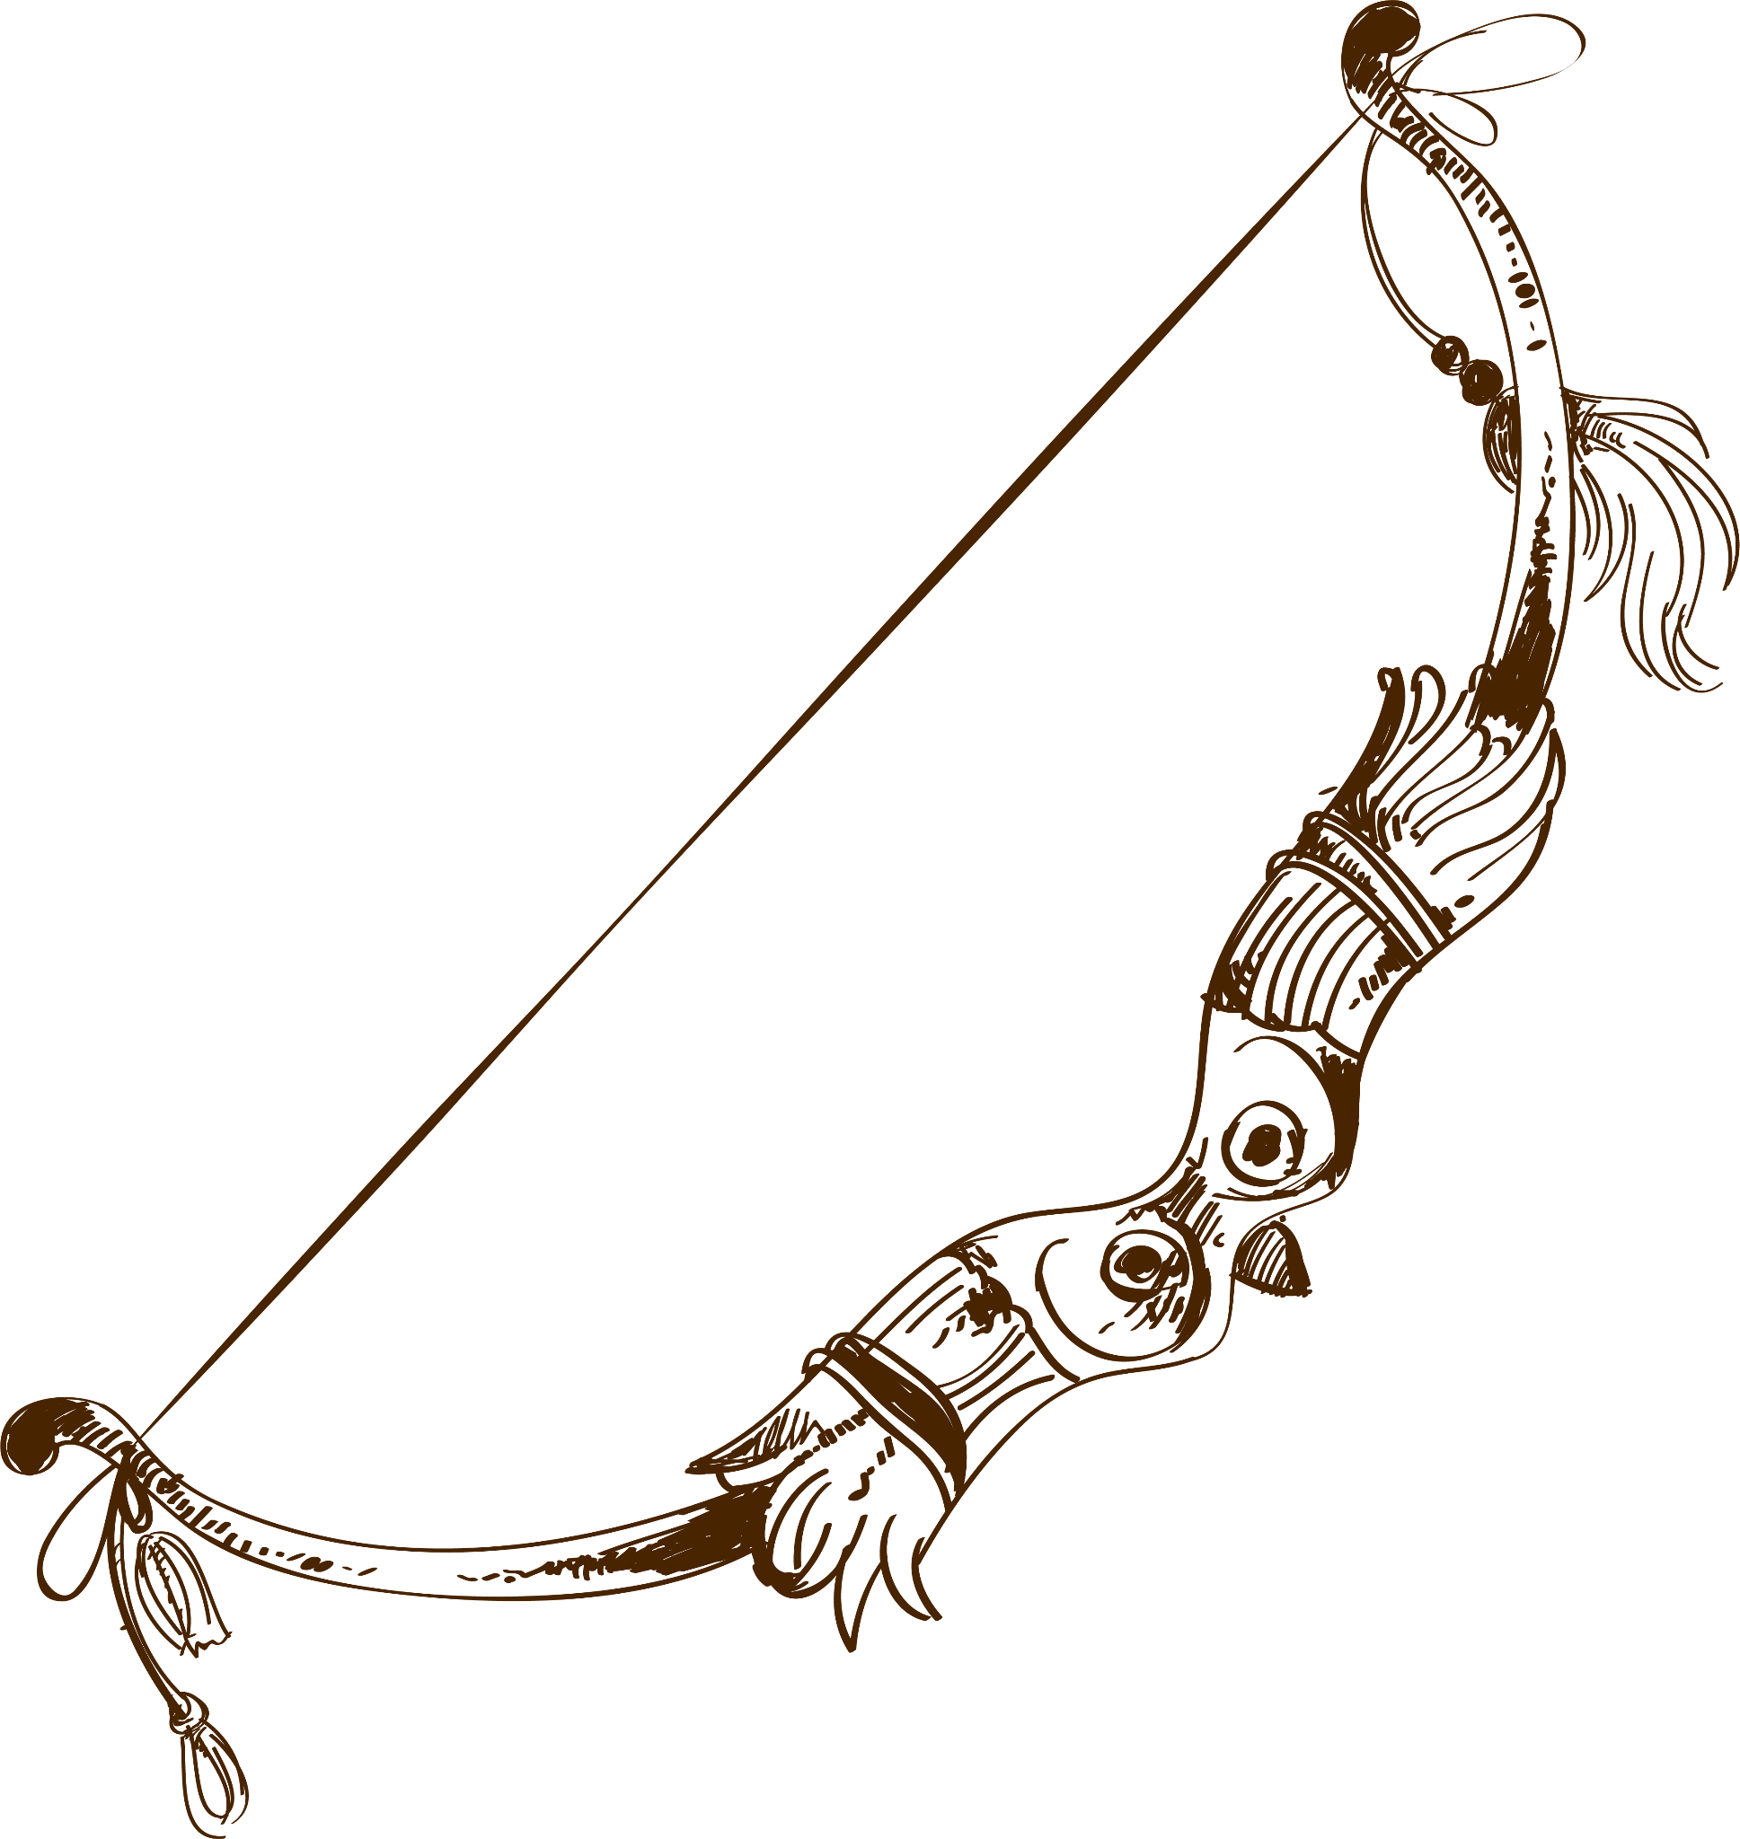
Nolan Bushnell
“Father of electronic gaming”
February 5, 1943

Slide 3
–Nolan Bushnell
“The ultimate inspiration is the deadline”

Slide 4

Bushnell’s Leadership Style→ Transformational
Preached that lessons are learned in failure as much as success
Inspired others through innovation & business planning
Had the ability to find creative employees

Slide 5
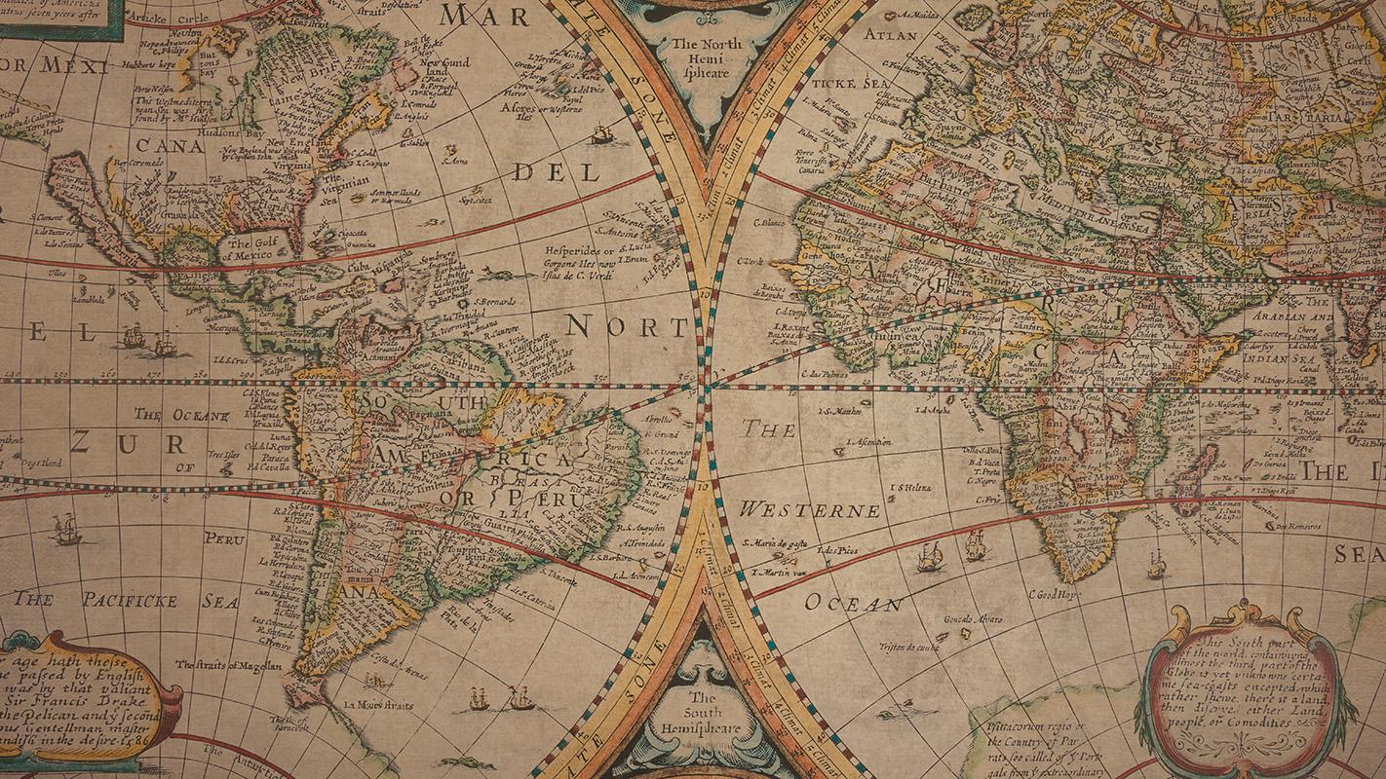
Impact Bushnell had During his Leadership & Effect on Today’s Methods
Led with mindfulness rather than anger or frustration
Set the framework of computerized gaming
Hired based on work ethic rather than job / education experiences
Empowered the ideas of innovation
Pushed the idea that “timing is everything”
Through failure, he remained resilient
An idea isn’t enough, how will your ideas be executed?

Slide 6
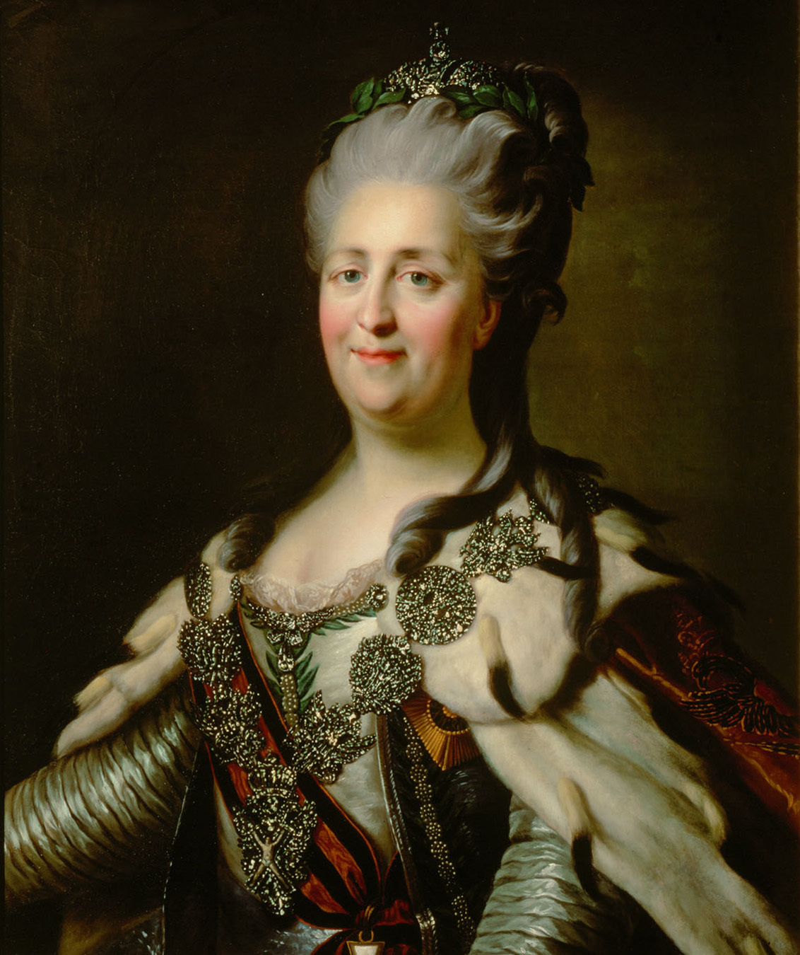
Catherine the Great
May 2, 1729 - November 17, 1796

Slide 7
–Catherine the Great
“I shall be an autocrat: that's my trade. And the good Lord will forgive me: that's his.”

Slide 8
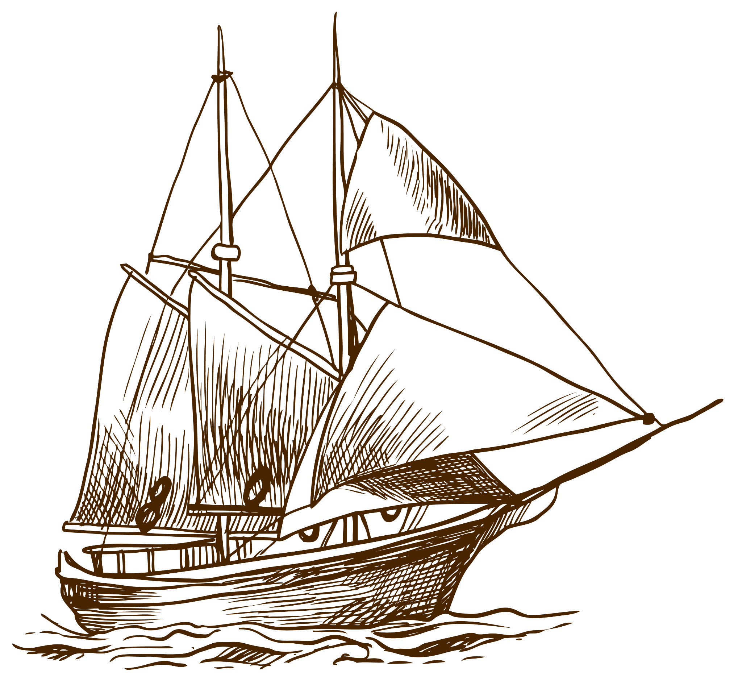
Catherine’s Leadership Style→ Autocratic
Expanded the Russian Empire by 200,000 miles
Appointed by the palace but had absolute power to make decisions
Longest ruling female leader of Russia (1762-1796)

Slide 9
Impact Catherine had During her Leadership & Effect on Today’s Methods
Modernized Russia
Reformed education
  The arts
  Created schools that taught independently of the church
Reformed Russian law code
  liberal humanitarian political theories
Source of national pride
Use power to all’s advantage
Women can lead
Modern principles can be applied to established orders
Modernization can be brought upon old ideas

Slide 10
How They Compare & Contrast
Bushnell
Catherine
Similarities
Technological inventor; brought new ideas that stemmed from technology
Respected world leader; brought new ideas that stemmed from Europe
Led with ideas of innovation , modernization, & perseverance

